Slide 1
Virtual Memory
Lecturer: Li Yang
Contact: liyang23@swjtu.edu.cn
Office: X31506
Faculty: Computer and AI

Slide 2
Outline
Operating System Software
  Fetch (读取) Policy
  Placement（放置） Policy
  Replacement（置换） Policy
  Resident Set （常驻集） Management
  Cleaning （清除）Policy
  Load Control （加载控制）

Slide 3
Operating System Software
The design of the memory management portion of an OS depends on three fundamental areas of choice:
  Whether or not to use virtual memory techniques
  The use of paging or segmentation or both
  The algorithms employed for various aspects of memory management
  Depend on the hardware platform
Belong to operating system software, minimize the rate at which page faults occur

Slide 4
Overhead during Page Fault Error
deciding which resident pages to replace
the I/O operation of exchanging pages
the OS must schedule another process to run during the page I/O
When a process is executing，the probability of referencing a word on a missing page is minimized

Slide 5
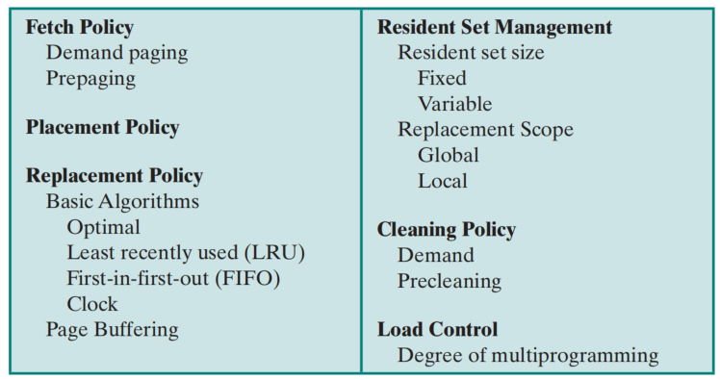
Operating System Policies for Virtual Memory
When
Where
(Segment only)
Which

Slide 6
1. Fetch Policy
Determines when a page should be brought into memory
  Demand Page （请求分页）
  Prepaging （预先分页）
Two main types:
Demand Paging
Prepaging

Slide 7
Fetch Policy
Demand Paging（请求分页）
  only brings pages into main memory when a reference is made to a location on the page
  many page faults when process is first started
  Principle of locality （局部性原理） suggests that as more and more pages are brought in, most future references will be to pages that have recently been brought in, and page faults should drop to a very low level

Slide 8
Fetch Policy
Prepaging（预先分页）
  pages other than the one demanded by a page fault are brought in
  should not be confused with “swapping”
  Advantages:
    exploits the characteristics of most secondary memory devices.
    if pages of a process are stored contiguously in secondary memory it is more efficient to bring in a number of pages at one time
  Disadvantages: ineffective if extra pages are not referenced

Slide 9
2. Placement Policy
Determines where in real memory a process piece is to reside
Important design issue in a segmentation system, such as Best-Fit, Next-Fit, First-Fit
Paging or combined paging with segmentation placing is irrelevant because hardware performs functions with equal efficiency

Slide 10
3. Replacement （置换）Policy
Deals with the selection of a page in main memory to be replaced when a new page must be brought in
      objective is that the page that is removed be the page least likely to be referenced in the near future
The more elaborate the replacement policy, the greater the hardware and software overhead to implement it
Algorithms used for the selection of a page to replace:
  Optimal
  Least recently used (LRU)
  First-in-first-out (FIFO)
  Clock

Slide 11
Frame Locking
When a frame is locked the page currently stored in that frame may not be replaced
  kernel of the OS as well as key control structures are held in locked frames
  I/O buffers and time-critical areas may be locked into main memory frames
  locking is achieved by associating a lock bit with each frame

Slide 12
Replacement （置换）Policy
Algorithms used for the selection of a page to replace:
  Optimal（最优，OPT）
  Least recently used (最近最少使用，LRU)
  First-in-first-out (FIFO)
  Clock

Slide 13
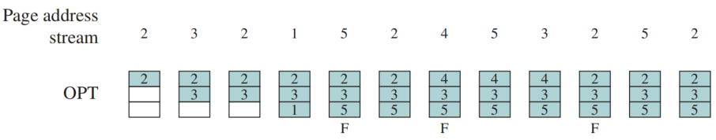
Optimal Policy
Selects the page for which the time to the next reference is the longest
Produces three page faults after the frame allocation has been filled
This policy is impossible to implement, because it would require the OS to have perfect knowledge of future events.
F = page fault occurring after the frame allocation is initially filled

Slide 14

Least Recently Used (LRU)
Replaces the page that has not been referenced for the longest time
By the principle of locality, this should be the page least likely to be referenced in the near future
Difficult to implement
  one approach is to tag each page with the time of last reference
  Another is to maintain a visited stack.
  Both require a great deal of overhead

Slide 15
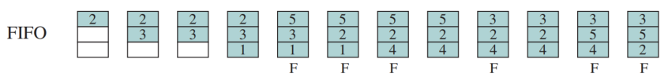
First-in-First-out (FIFO)
Page that has been in memory the longest is replaced
Treats page frames allocated to a process as a circular buffer
Pages are removed in round-robin style
  simplest replacement policy to implement

Slide 16
Clock Policy
Requires the association of an additional bit with each frame，referred to as the use bit
The set of frames is considered to be a circular buffer
find a frame with a use bit set to 0 to replace new page
  Case1: When a page is first loaded in memory or referenced, the use bit is set to 1
  Case2: encounters a frame with a use bit of 1, it resets that bit to 0 and continues on.
  Case3: If all frames’ use bits are 0, the first such frame encountered is chosen for replacement.
  Case4: If all frames’ use bits are 1, setting all the use bits to 0, and stop at its original position, replacing the page in that frame.

Slide 17
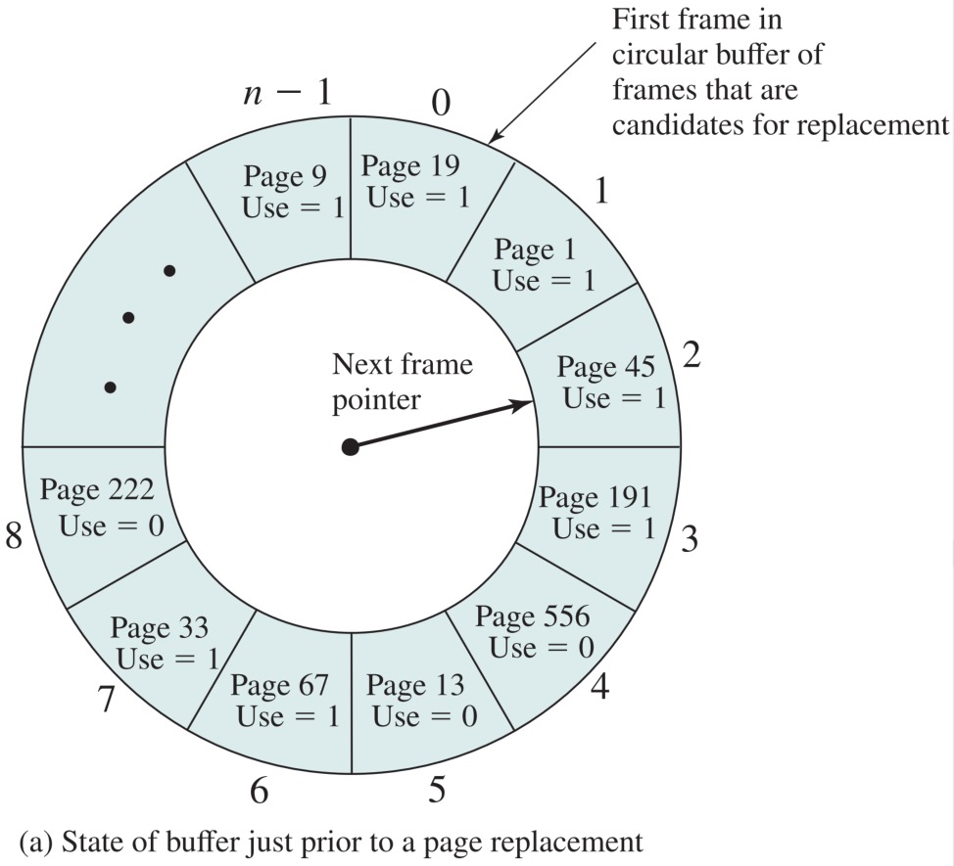
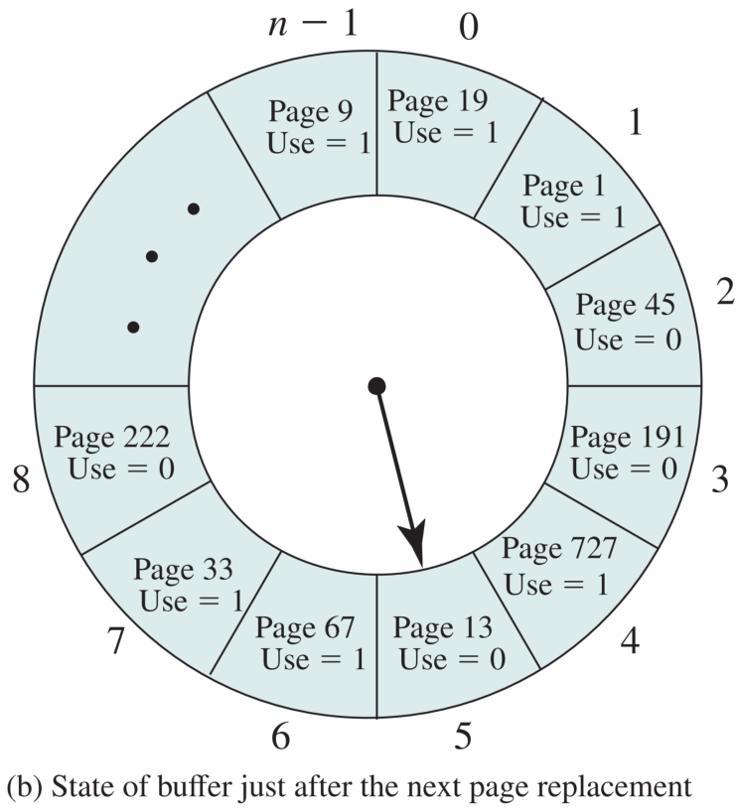
Clock Policy

Slide 18

Clock Policy
Each time it encounters a frame with a use bit of 1, it resets that bit to 0 and
continues on. If any of the frames in the buffer have a use bit of 0 at the beginning of
this process, the first such frame encountered is chosen for replacement. If all of the
frames have a use bit of 1, then the pointer will make one complete cycle through the
buffer, setting all the use bits to 0, and stop at its original position, replacing the page
in that frame.
  The set of frames is considered to be a circular buffer, with a pointer，
  When a page is replaced, the pointer is set to indicate the next frame in the buffer after the one just updated

Slide 19
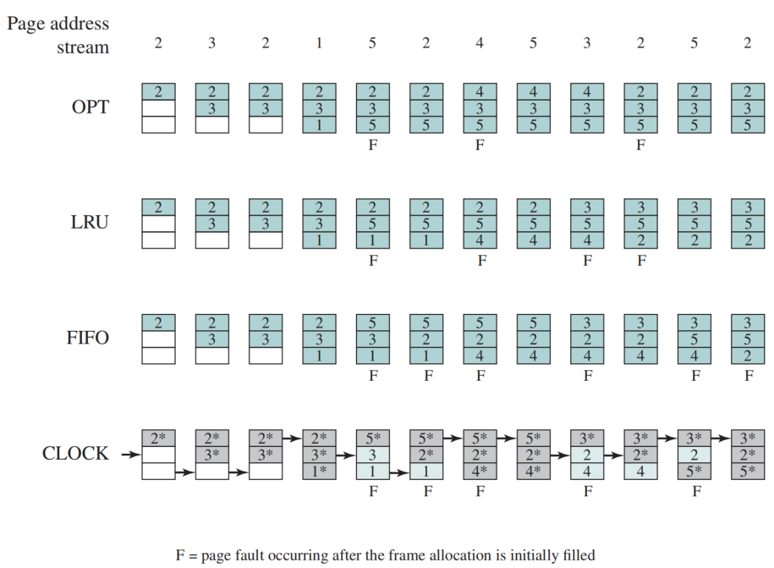
Combined Examples
Behavior of Four Page Replacement Algorithms

Slide 20
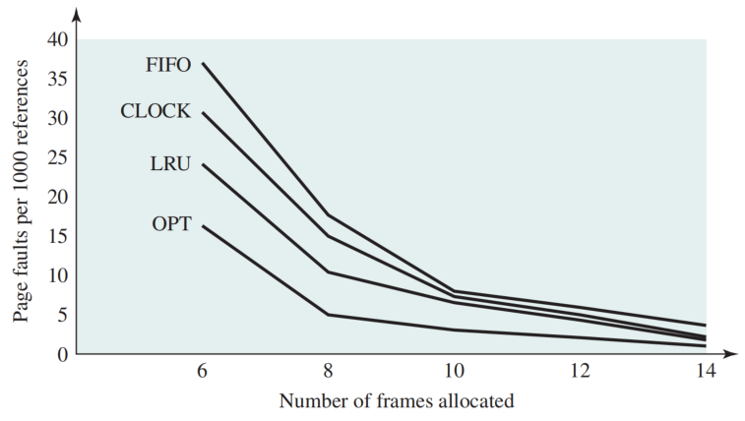

Comparison of Algorithms
Comparison of Fixed-Allocation, Local Page Replacement Algorithms

Slide 21
Page Buffering
Improves paging performance and allows the use of a simpler page replacement policy
A replaced page is not lost, but rather assigned to one of two lists:
Free page list
list of page frames available for reading in pages
Modified page list
pages are written out in clusters

Slide 22
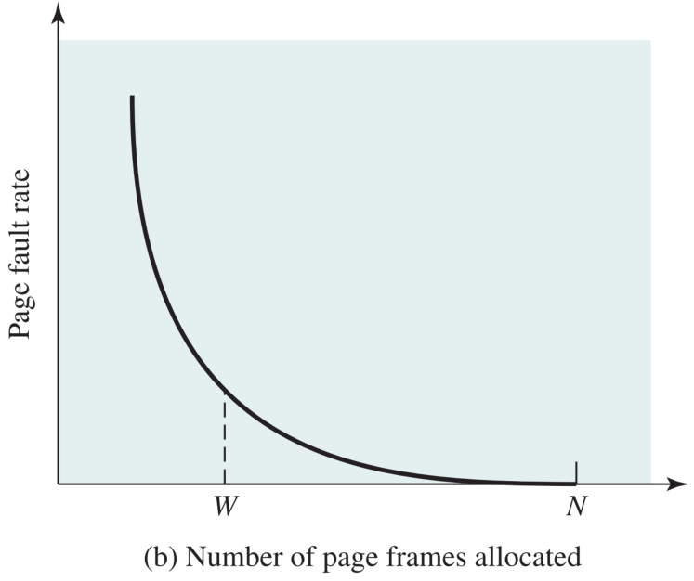
4. Resident Set Management
Definition: the portion of a process that is actually in main memory at any time is defined to be the resident set of the process
How many page frames are to be allocated to each active process
The set of pages for replacement should be limited to the process or all the page frames in main memorys
  The smaller the amount of memory allocated to each process, the more processes can reside in memory
  The small number of pages loaded increases page faults
  Beyond a certain size, further allocations of pages will not effect the page fault rate

Slide 23
4. Resident Set (常驻集) Management
Definition: the portion of a process that is actually in main memory at any time is defined to be the resident set of the process
How many page frames are to be allocated to each active process
The set of pages for replacement should be limited to the process or all the page frames in main memorys
  The smaller the amount of memory allocated to each process, the more processes can reside in memory
  The small number of pages loaded increases page faults
  Beyond a certain size, further allocations of pages will not effect the page fault rate

Slide 24
Resident Set Size
Fixed-allocation
  gives a process a fixed number of frames in main memory within which to execute
  when a page fault occurs, one of the pages of that process must be replaced
Variable-allocation
  allows the number of page frames allocated to a process to be varied over the lifetime of the process
  Ideally:
    High page fault, increase the allocated pages
    Low page fault, decrease the allocated pages

Slide 25
Replacement Scope
The scope of a replacement strategy can be categorized as global or local
  both types are activated by a page fault when there are no free page frames
Local
  chooses only among the resident pages of the process that generated the page fault
Global
  considers all unlocked pages in main memory

Slide 26
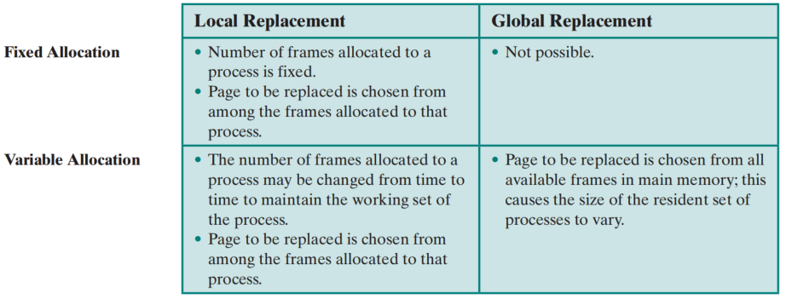

Resident Set Management Summary

Slide 27
Fixed Allocation, Local Scope
Necessary to decide ahead of time the amount of allocation to give a process
If allocation is too small, there will be a high page fault rate
If allocation is too large, there will be too few programs in main memory
  increased processor idle time
  increased time spent in swapping

Slide 28
Variable Allocation, Global Scope
Easiest to implement
  adopted in a number of operating systems
OS maintains a list of free frames
  When a page fault occurs, free frame is added to resident set of process
If no frames are available, the OS must choose a page currently in memory to replace
  Difficulty——there is no discipline to determine which process should lose a page from its resident set.

Slide 29
Variable Allocation, Local Scope
Allocation: when a new process is loaded into main memory, allocate to it a certain number of page frames as its resident set
Scope: when a page fault occurs, select the page to replace from among the resident set of the process that suffers the fault
Variation: From time to time, Reevaluate the allocation provided to the process, increase or decrease it to improve overall performance

Slide 30
Variable Allocation, Local Scope
Decision to increase or decrease a resident set size is based on the assessment of the likely future demands of active processes
Key elements:
criteria used to determine resident set size
the timing of changes
One of strategies: Working Set Strategy

Slide 31
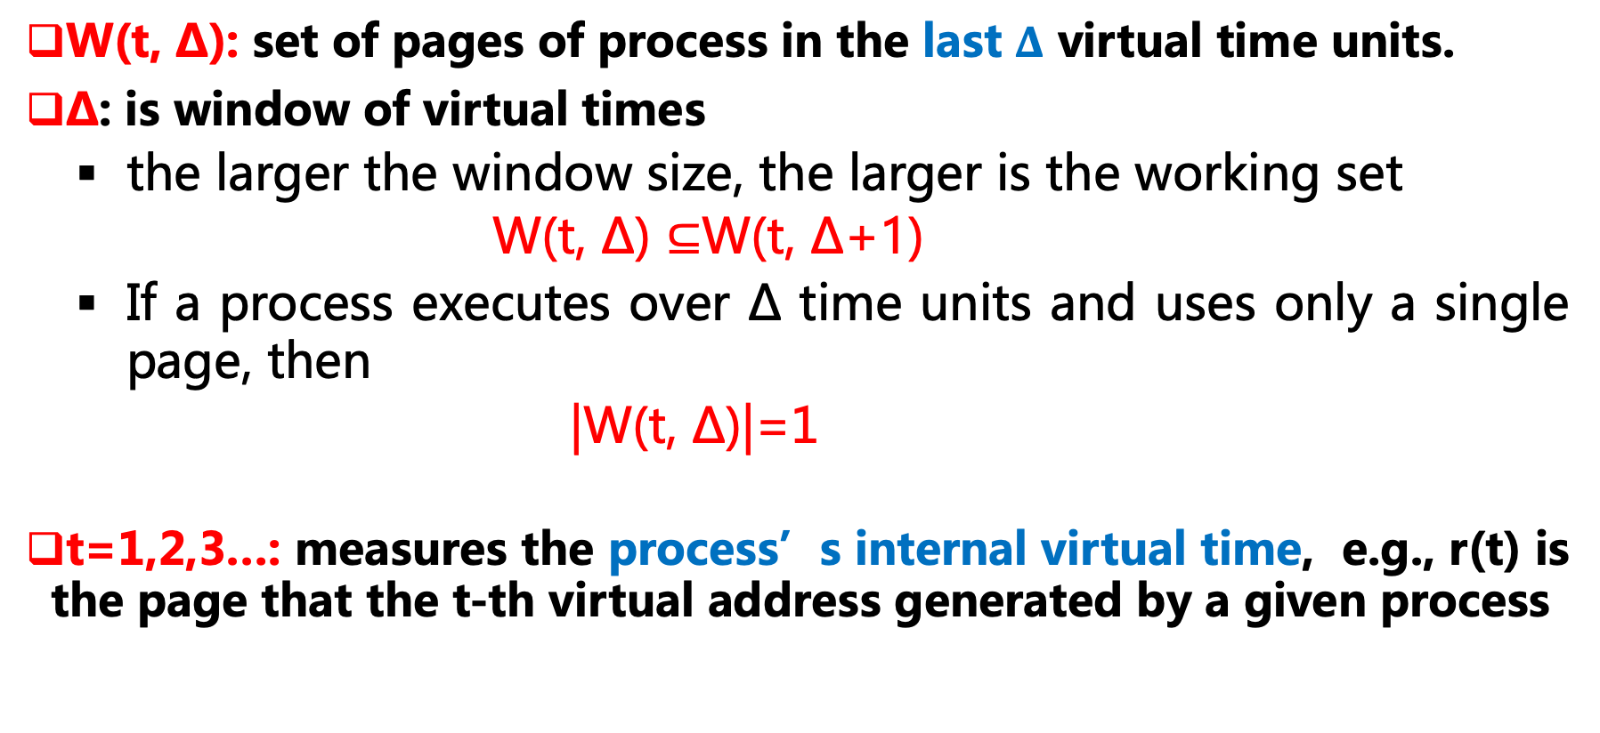
Working Set Strategy
W(t, ∆): set of pages of process in the last $Δ$ virtual time units.
∆: is window of virtual times
  the larger the window size, the larger is the working set
      W(t, ∆) ⊆W(t, ∆+1)
  If a process executes over ∆ time units and uses only a single page, then
  |W(t, ∆)|=1
t=1,2,3…: measures the process’s internal virtual time, e.g., r(t) is the page that the t-th virtual address generated by a given process

Slide 32
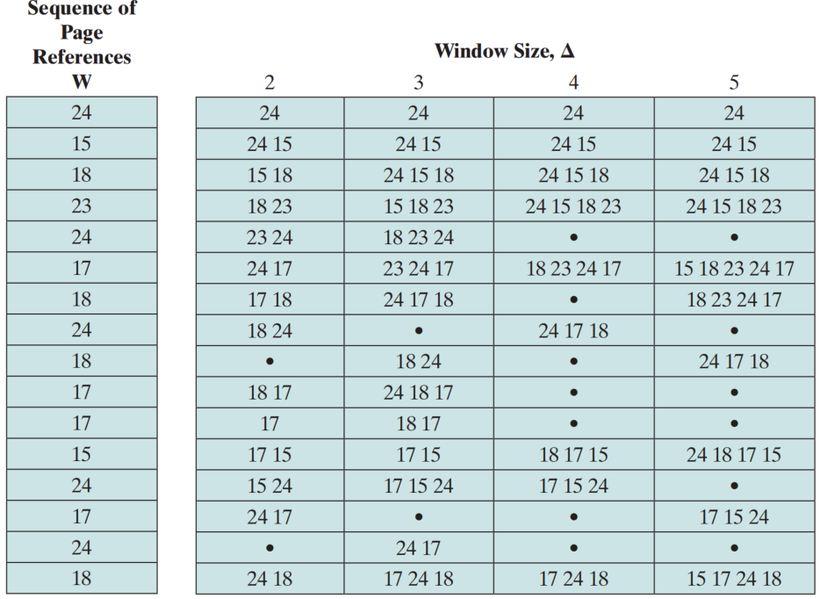
Working Set Strategy

Slide 33
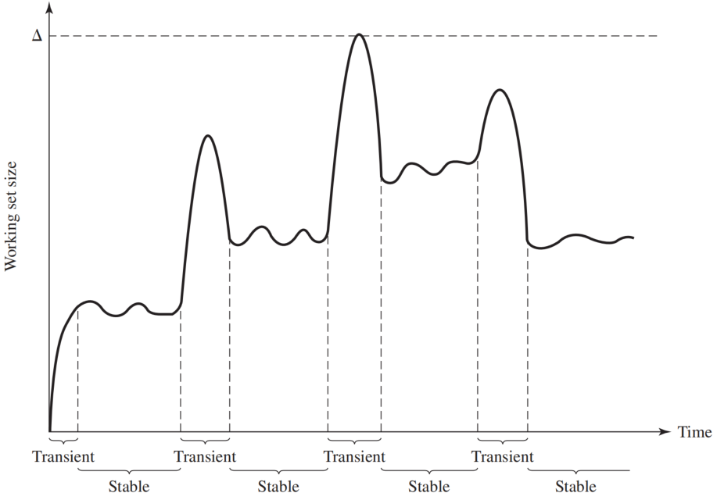
Working Set Strategy
The working set size can vary over time for a fixed value of ∆.
First begins executing, it gradually builds up to a working set
The process stabilize on a certain set of pages
New pages are referenced
As the window slides past these page references, the working set size declines
Typical Graph of Working Set Size

Slide 34
Guidance for Resident Size
Principles of working set guided strategies for resident set size
  Monitor the working set of each process.
  Periodically remove from the resident set of a process those pages that are not in its working set.
  A process may execute only if its working set is in main memory

Slide 35
Guidance for Resident Size
Issues of the strategies based on working set
  The past does not always predict the future. Both the size and the membership of the working set will change over time
  A true measurement of working set for each process is impractical due to the time-stamp of each process.
  The optimal value of ∆ is unknown and in any case would vary

Slide 36
Guidance for Resident Size
Another idea: page fault rate guided strategies

Slide 37
Page Fault Frequency (PFF)
Practical strategy: focus on the time interval of page fault
Requires a use bit to be associated with each page in memory
  Bit is set to 1 when that page is accessed

Slide 38

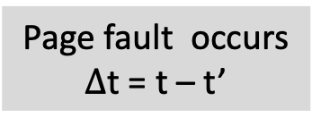
Page Fault Frequency (PFF)
When a page fault occurs, the OS notes the virtual time since the last page fault for that process
  If less than the threshold F, the page is added to the resident set
  Otherwise, discard(扔掉) all pages with a use bit of 0, and shrink the resident set. Reset the use bit on the remaining pages of the process to 0. the page is add.
Page fault occurs
$Δ$t = t – t’
If $Δt≤F$
Y
Page is added to the resident set
Reset the remaining pages’ use bit to 0
N
Discard the pages with a use bit of 0

Slide 39
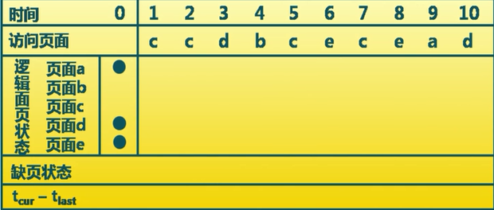
Page Fault Frequency (PFF)
threshold = 2

Slide 40
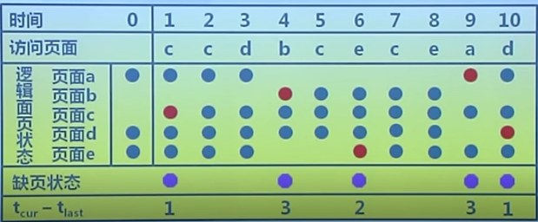
Page Fault Frequency (PFF)
threshold = 2

Slide 41
Cleaning Policy
Concerned with determining when a modified page should be written out to secondary memory
Demand Cleaning
  a page is written out to secondary memory only when it has been selected for replacement
  Issue：suffers a page fault may have to wait for two page transfers. This may decrease processor utilization.
Precleaning
  writes modified pages before their page frames are needed so pages can be written out in batches.
  Issue: the pages may be modified again before they are replaced.

Slide 42

Load Control
Determines the number of processes that will be resident in main memory
  multiprogramming level
Critical in effective memory management
  Too few processes, many occasions when all processes will be blocked and much time will be spent in swapping
  Too many processes will lead to thrashing
A working set or PFF algorithm implicitly incorporates load control
Example: L=S Criterion

Slide 43
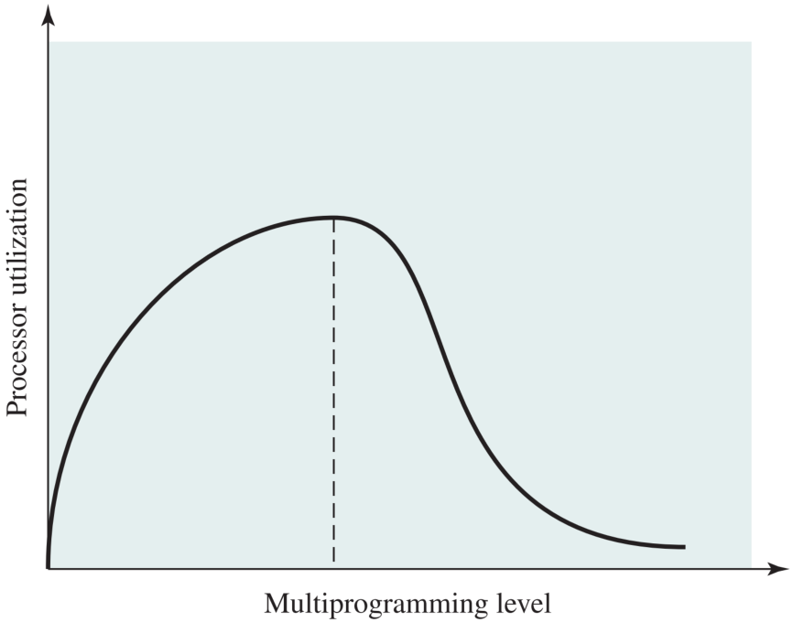
Multiprogramming Effects

Slide 44
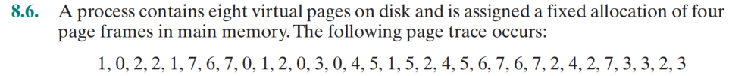
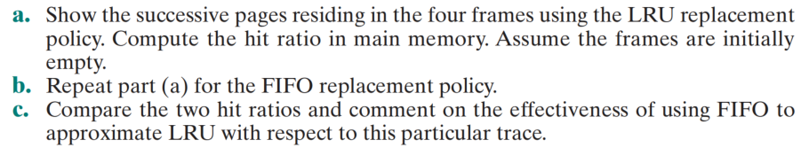
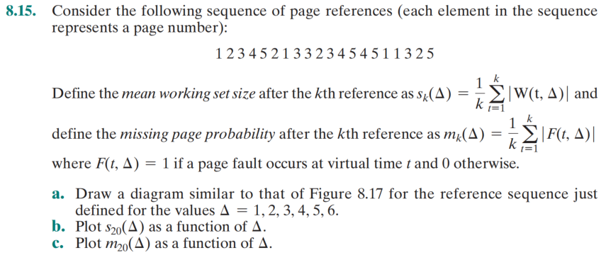
Quiz

Slide 45
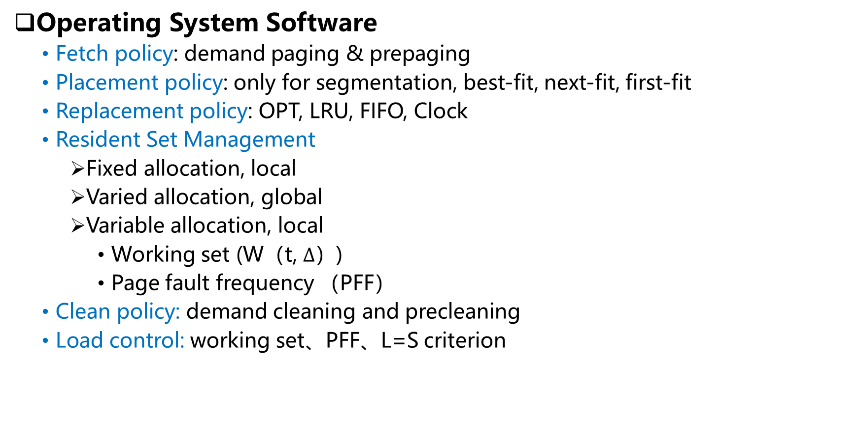
Summary
Operating System Software
  Fetch policy: demand paging & prepaging
  Placement policy: only for segmentation, best-fit, next-fit, first-fit
  Replacement policy: OPT, LRU, FIFO, Clock
  Resident Set Management
    Fixed allocation, local
    Varied allocation, global
    Variable allocation, local
      Working set (W（t, $Δ$）)
      Page fault frequency （PFF）
  Clean policy: demand cleaning and precleaning
  Load control: working set、PFF、L=S criterion

